Slide 1
Interactive visual labelling versus active learning: an experimental comparison
Reference:
Chegini, M., Bernard, J., Cui, J. et al. Interactive visual labelling versus active learning: an experimental comparison. Front Inform Technol Electron Eng 21, 524–535 (2020). https://doi.org/10.1631/FITEE.1900549
Link to the paper:
https://link.springer.com/article/10.1631/FITEE.1900549#citeas

Slide 2
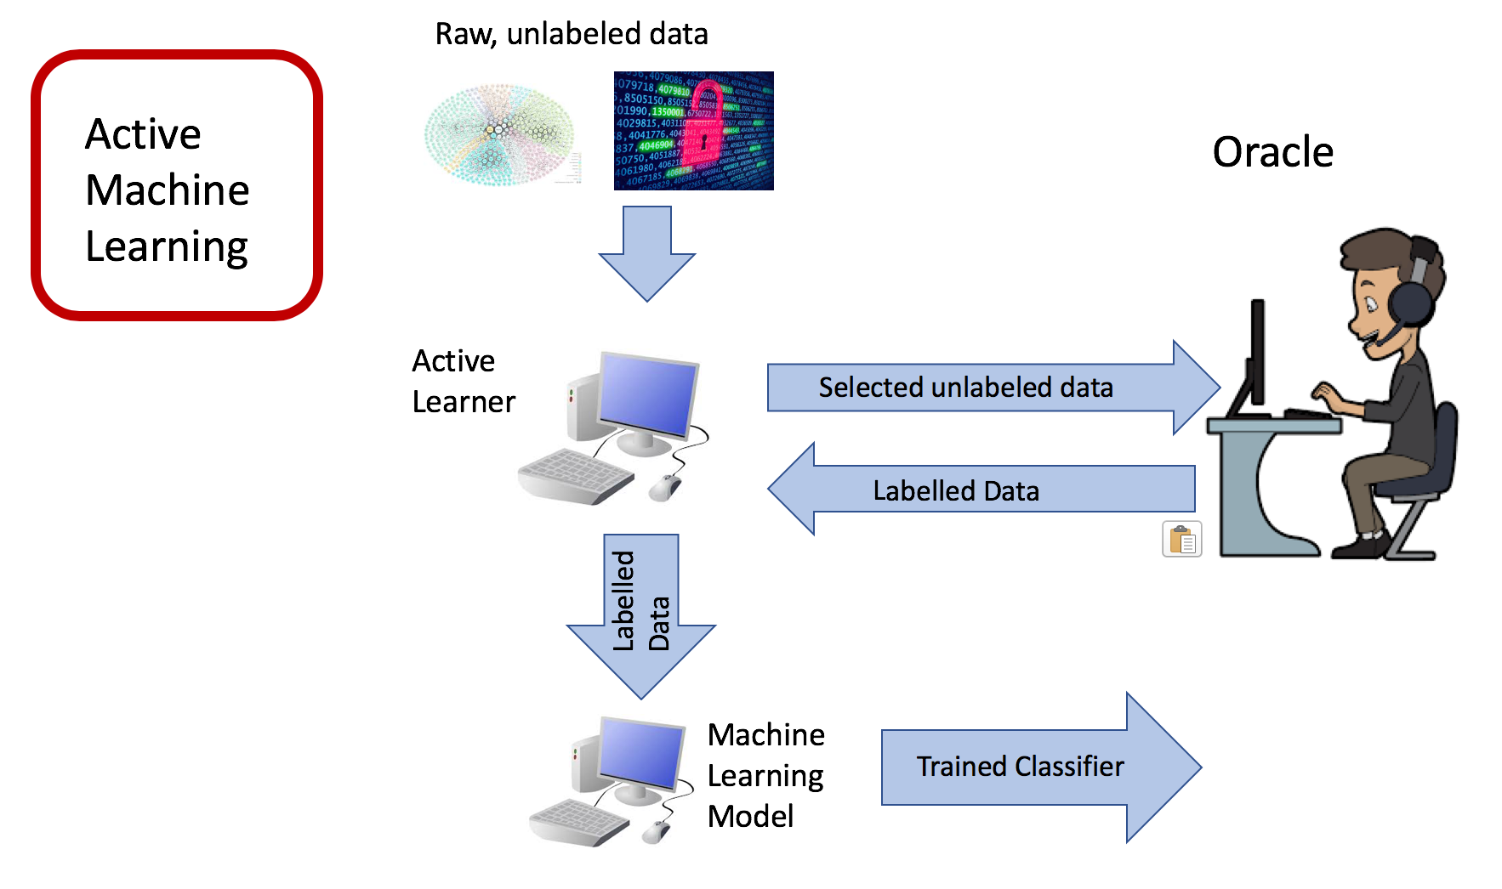
What is Active Learning?

Slide 3
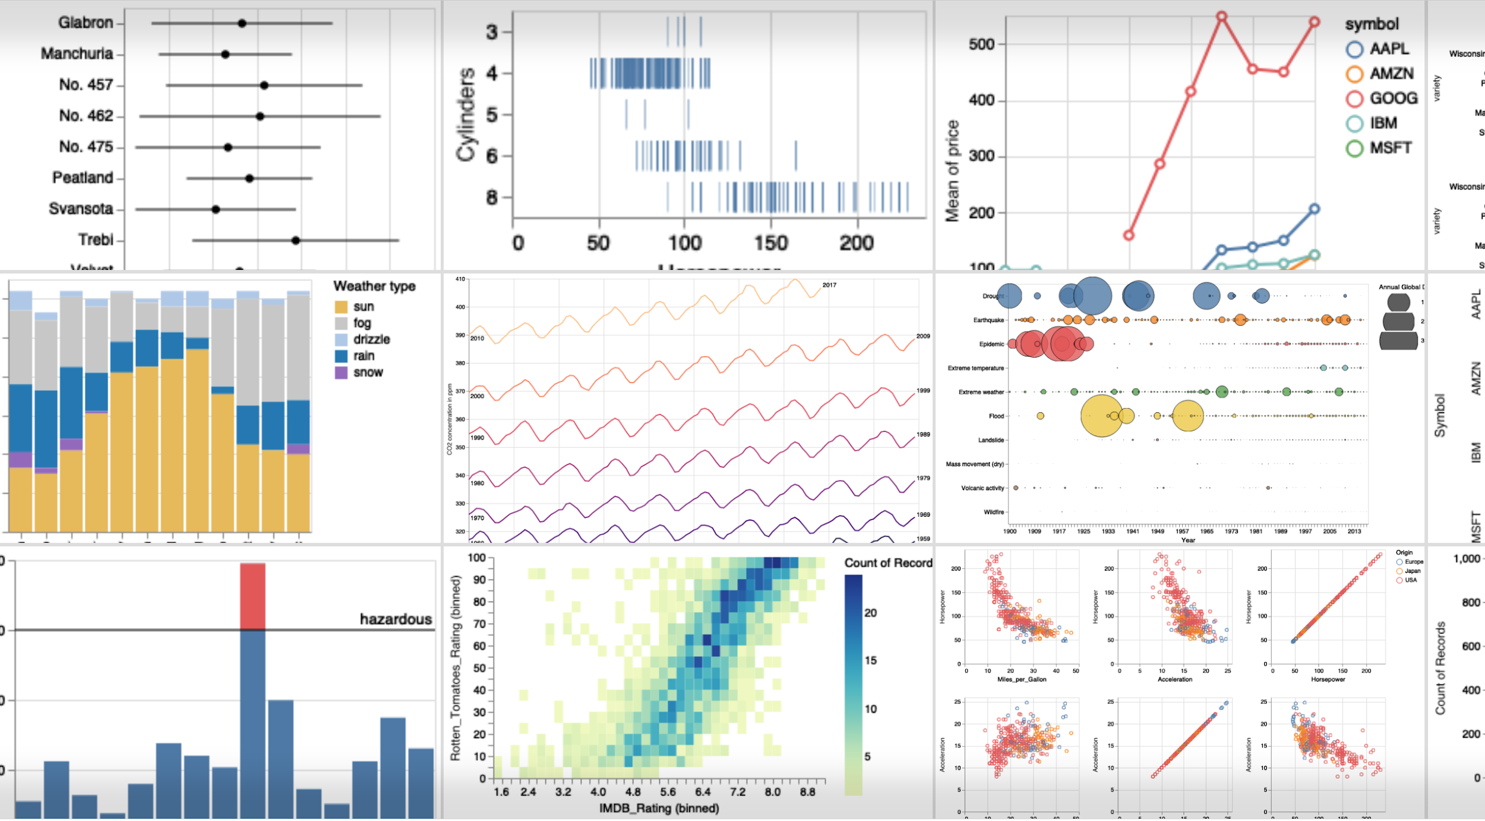
What is Interactive Visualization?

Slide 4
What is the problem?
One-shot Problem
Not possible to reliably estimate the performance
Active learning
No evaluation set

Slide 5
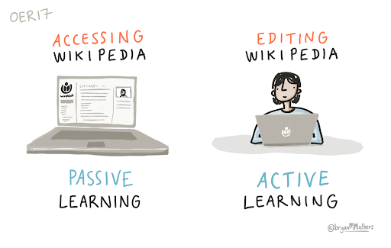

What are the usual methods for classification?
Passive learning
Active Learning
Interactive visualization

Slide 6
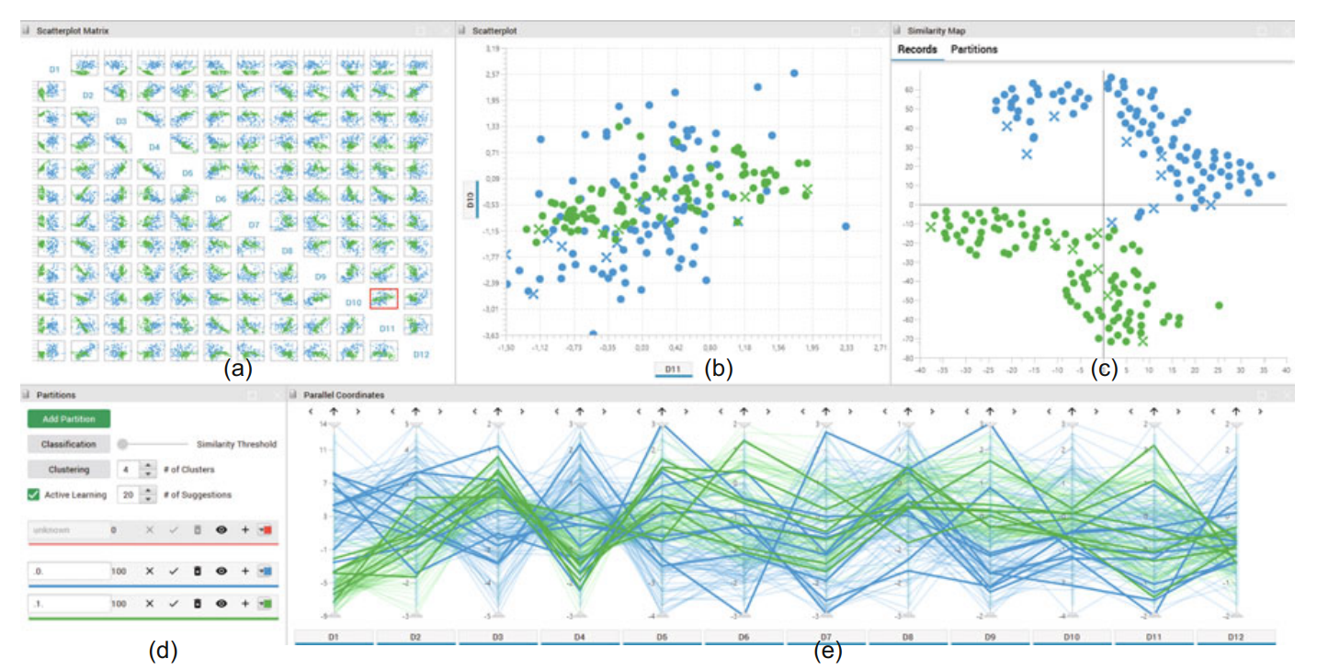
What is the proposed method?
(a)-ScatterPlotMatrix
(b)-ScatterPlot
(c)-Similarity Map
(d)-Parallel Coordinate
(e)-Currently defined axis

Slide 7
What are the already existing methods ?
Smallest margin
Entropy based sampling
Least significant confidence

Slide 8
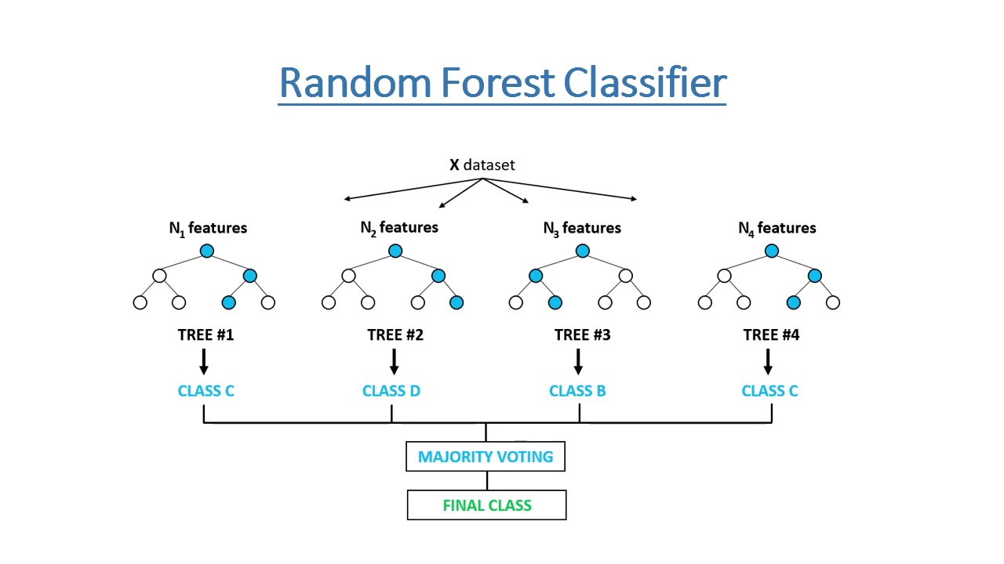
What ML technique is used here and why ?
While performing AL and interactive labelling
Remove any potential bias
Provides good visual Feedback

Slide 9
What type of visual tool is used here and why?
Add instances
Filtering and color coding support
Create groups
mVis
Name groups
Effective comparison

Slide 10
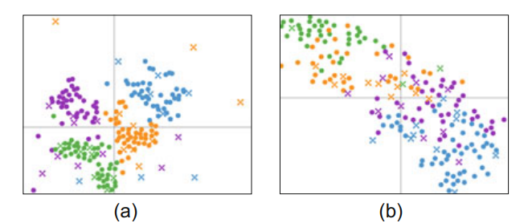
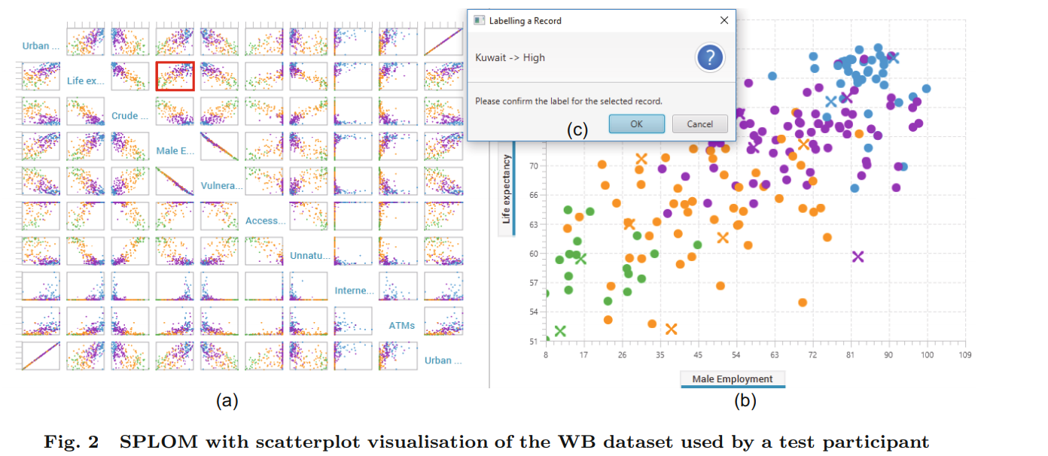
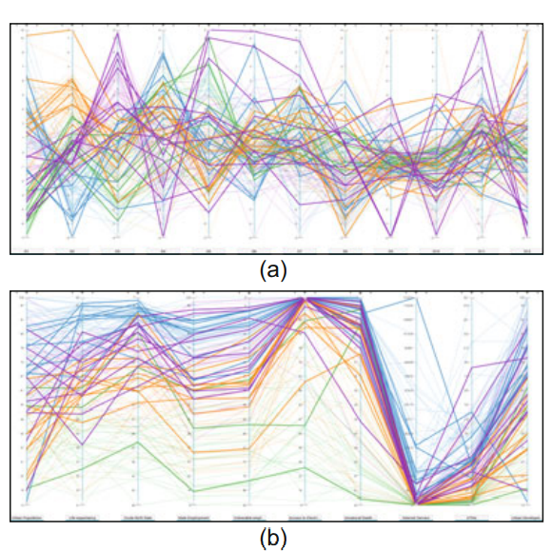
What is the working of mVis tool ?

Slide 11
What Dataset is being used?
MNIST
A socio-economic statistical dataset published by the World Bank
https://data.worldbank.org/country

Slide 12
What techniques are used for the classification performance?
Classification
Performance
Greedy technique
Active learning
random selection
Instance were run 200 times
Performs all labelling strategies
1. Smallest margin.
2. Entropy sampling.
3. least significant confidence.
Average accuracy

Slide 13
What is the design for studying these three visualizations?
How do three individual visualisation techniques (similarity map, SPLOM, and parallel coordinates) compare in terms of accuracy ?
How are these three techniques are better when compared to the non-interactive visualizations?
Which technique is rated high by the user, in terms of user experience?
Did users chose different labelling strategies based on the visualization?

Slide 14
Who are the participants and setup?
1
2
3
4
Introduction & Background questionnaire
Demonstration of mVis and practice
Allowing user to perform analysis
Interview and feedback

Slide 15
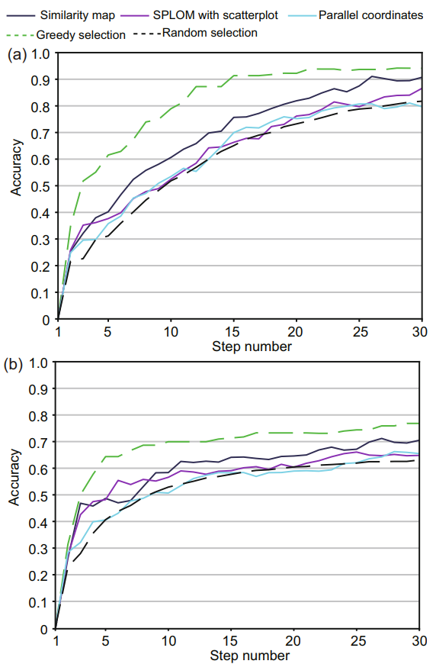
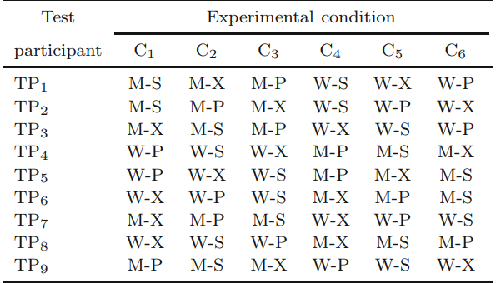
Results based on the interactive visualisation techniques

Slide 16
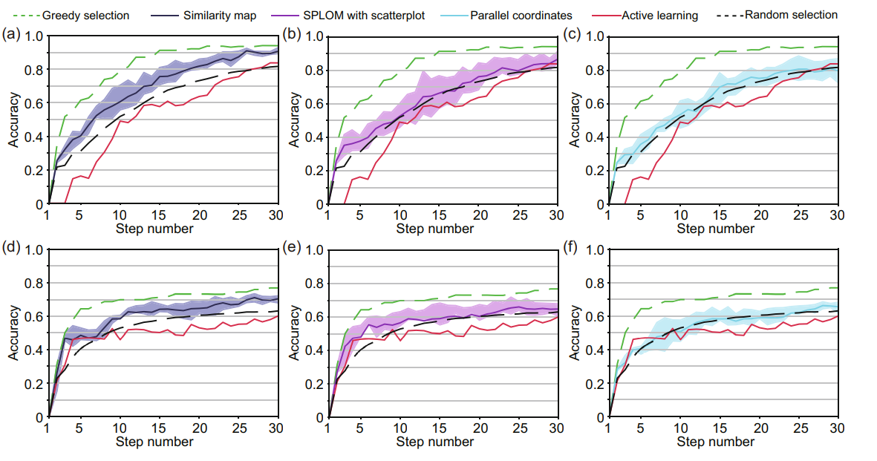
Interactive visual labelling VS Active learning

Slide 17
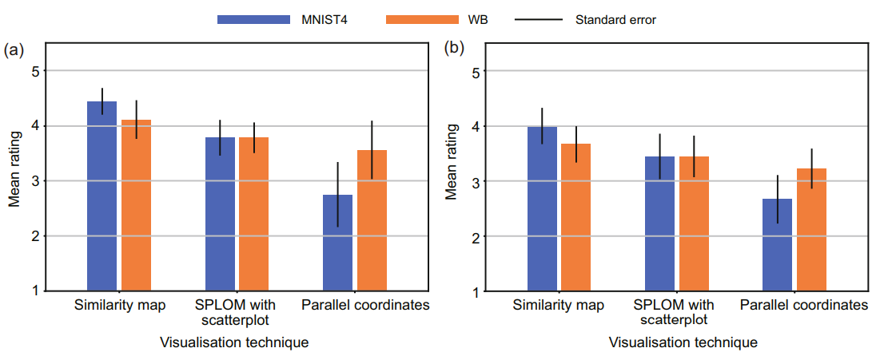
Mean ratings from Users

Slide 18
Discussion
The classification performance of interactive visual labelling techniques can outperform those of AL selection strategies.
It is analyzed that similarity map is less complex than the other methods of visualization.
It is also observed that users who are familiar with parallel coordinates perform better and are more confident in using it for label decision making.

Slide 19
Future Work
The number of settings were fixed, which could be varied as well.
Including more AL techniques and visualization than just using three.
Using various classification algorithms.
The WB dataset could be presented as map views

Slide 20
Conclusion
A study
comparing three interactive visualisations with each other and with active learning for the purpose of labelling a multivariate dataset
1
Performance
All three interactive visualisations performed better than active learning algorithms, in terms of classification accuracy
2
Results
The similarity map performed better than both SPLOM with scatterplot and parallel coordinates in both the MNIST04 and WB datasets.
3
User benefits
The results support the view that a user-in-the-loop approach is beneficial for creating training datasets
4

Slide 21
Thanks!

